Slide 1
ROS-Industrial Basic Developer’s Training Class
May 2014
Dan Solomon
Research Engineer
Southwest Research Institute

Slide 2
Outline
Services
Actions
Launch Files
TF
URDF
Debugging

Slide 3
Services

Slide 4
Services: Overview
Services are like a function calls
Each service made up of 2 messages:
Request, sent by client, received by server
Response, generated by server, sent to client
Service is defined in plain text format
Supports basic types, and predefined msg types
Call to service blocks in client
Code will wait for service call to complete before continuing

Slide 5
Services: Lesson 2.1
Create custom service definition
Create service server
Create service client
int64 a
int64 b
---
int64 sum
bool add(AddTwoInts::Request &req, AddTwoInts::Response &res) {
res.sum = req.a + req.b;
return true;
}
ros::ServiceServer service = n.advertiseService("add_two_ints", add);
Ros::NodeHandle nh;
ros::ServiceClient client = nh.serviceClient<AddTwoInts>("add_two_ints");
AddTwoInts srv;
srv.request.a = 4;
srv.request.b = 12;
client.call(srv);

Slide 6
Actions

Slide 7
Actions: Overview
Actions are like messages and like services
Each action made up of 3 messages:
Goal, sent by client, received by server
Result, generated by server, sent to client
Feedback, generated by server
Non-blocking in client
Allows long-duration activity, with ability to monitor feedback and even cancel before completion

Slide 8
Actions: Practical Application
Useful for processes that take time
Moving arm
Calculate trajectory
Not worthwhile for short information request
Where is robot
Not appropriate for most sensor data
What is distance sensor reading
What is pressure reading
Could be good for closed loop control

Slide 9
Actions: Lesson 2.2
Create custom action definition
Create action server
Create action client
int32 order
---
int32[] sequence
---
int32[] sequence
void executeCB(const FibonacciGoalConstPtr &goal) { …
if (as_.isPreemptRequested() || !ros::ok()) as_.setPreempted();
as_.publishFeedback(…);
as_.setSucceeded(result_); }
…
SimpleActionServer<FibonacciAction> as_ (nh_, name, boost::bind(&executeCB, this, _1), false);
as_.start();
ros::spin();
SimpleActionClient<FibonacciAction> ac("fibonacci", true);
FibonacciGoal goal;
goal.order = 20;
ac.sendGoal(goal);

Slide 10
Actions: Lesson 2.3
Fill out a trajectory
Send action to ROS-Industrial robot client
View activity using industrial robot simulator
trajectory_msgs::JointTrajectory trajectory;
trajectory_msgs::JointTrajectoryPoint pt;
trajectory.points.push_back(pt);
actionlib::ActionClient<control_msgs::FollowJointTrajectoryAction>
ac(nh, "joint_trajectory_action");
control_msgs::FollowJointTrajectoryActionGoal goal;
goal.goal.trajectory = trajectory;
ac.sendGoal(goal.goal);

Slide 11
Message vs. Service vs. Action
Type | Strengths | Weaknesses
Message | Good for most sensors (streaming data) | Messages can be dropped without knowledge Easy to overload system with too many messages
Service | Knowledge of missed call Well-defined feedback | Blocks until completion Connection typically re-established for each service call (slows activity)
Action | Monitor long-running processes Handshaking (knowledge of missed connection) | Complicated Mixed feedback from multiple action servers (not for SimpleAction)

Slide 12
Launch Files

Slide 13
Launch Files: Overview
Launch files automate system startup
XML formatted script for running nodes and setting parameters
Ability to pull information from other packages

Slide 14
Launch Files: Notes
Can launch other launch files
Executed in order, without pause or wait*
* Parameters set to parameter server before nodes are launched
Can accept arguments
Can perform simple IF-THEN operations
Supported parameter types:
Bool, string, int, double, text file, binary file

Slide 15
Launch Files: Lesson 2.4
Basic launch
Script a list of nodes and parameters
<launch>
<rosparam param="controller_joint_names" >
['joint_s', 'joint_l', 'joint_e', 'joint_u', 'joint_r', 'joint_b', 'joint_t']
</rosparam>
<param name="robot_description“
textfile="$(find motoman_config)/cfg/sia20d_mesh.xml" />
<node name="robot_state_publisher" pkg="robot_state_publisher" type="robot_state_publisher" />
<node name="action_client" pkg="lesson_basic_launch“ type="jointaction_client"/>
</launch>

Slide 16
Launch Files: Lesson 2.5
Advanced launch
Include other launch files, even from other packages
Use arguments to parameterize launch
Use “if=“ or “unless=“ to do simple control
<launch>
<arg name="robot" default="sia20" />
<arg name="show_rviz" default="true" />
<group ns="robot" >
<include file="$(find lesson)/launch/load_$(arg robot)_data.launch" />
<node name=“state_publisher" pkg="robot_state_publisher“ type="state_publisher" />
<node name=“jt_state_publisher" pkg="joint_state_publisher" type="joint_state_publisher" /> </group>
<node name="rviz" pkg="rviz" type="rviz“ if="$(arg show_rviz)"/>
</launch>

Slide 17
TF – Transforms in ROS

Slide 18
TF: Overview
TF used to track all coordinate frames in ROS
Each frame is related to at least one other frame
TF can be used to find transforms between any two relatable frames, even in the past!
TF designed as a distributed network
“A,B”
Transform Between A/E?
“D,E”
Frame C
Frame E
“B,C,D”
Frame A
Frame B
Frame D

Slide 19
TF: c++
A transformListener listens to all tf messages and tries to determine relative transforms
Can try to transform in the past
Can only look as far back as it has been running
ros::init(argc, argv, "tf_listener");
ros::NodeHandle nh;
tf::TransformListener listener;
tf::StampedTransform transform;
listener.lookupTransform(“target”, “source”, ros::Time(), transform);

Slide 20
TF: c++
Each robot_state_publisher publishes transforms for a particular urdf
Nodes can also publish /tf data
DANGER! TF data can be conflicting
<launch>
<param name="robot_description" textfile="$(find motoman_config)/cfg/sia5.xml" />
<node name="state_publisher" pkg="robot_state_publisher" type=“robot_state_publisher" />
<node name="joint_state_publisher" pkg="joint_state_publisher" type="joint_state_publisher" />
</launch>
“D,E”
“A,B”
Transform Between A/E?
Frame C
Frame E
“B,C,D”
Frame A
Frame D
Frame B

Slide 21
URDF: Unified Robot Description Format

Slide 22

URDF: Overview
URDF is an XML-formatted file containing:
Links : coordinate frames and associated geometry
Joints : connections between links
Similar to DH-parameters (but way less painful)
Can describe entire workspace, not just robots
links
also
a “link”
joint

Slide 23
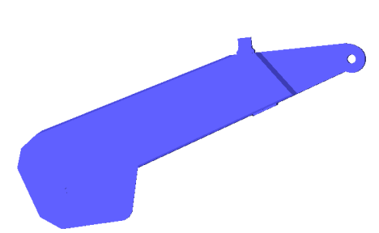
URDF: Link
A Link describes a physical or virtual object
Physical : robot link, workpiece, end-effector, ...
Virtual : TCP, robot base frame, ...
Each link becomes a TF frame
Can contain visual/collision geometry [optional]
<link name=“link_4“>
<visual> <geometry> <mesh filename=“link_4.stl"/> </geometry> <origin xyz="0 0 0" rpy="0 0 0" /> </visual> <collision> <geometry> <cylinder length="0.5" radius="0.1"/> </geometry> <origin xyz="0 0 -0.05" rpy="0 0 0" /> </collision>
</link>
visual
geometry
collision
geometry
frame
URDF Transforms
X/Y/Z, Roll/Pitch/Yaw
Meters / Radians

Slide 24
URDF: Joint
A Joint connects 2 Links
Defines a transform between parent and child frames
Types: fixed, free, linear, rotary
Denotes axis of movement (for linear / rotary)
Contains joint limits on position and velocity
ROS-I conventions
X-axis front, Z-Axis up
Keep all frames similarly rotated when possible
<joint name=“joint_2" type="revolute“> <parent link=“link_1"/> <child link=“link_2"/> <origin xyz=“0.2 0.2 0" rpy="0 0 0"/> <axis xyz=“0 0 1"/> <limit lower="-3.14" upper="3.14" velocity="1.0"/>
</joint>
joint_2
link_2
link_1

Slide 25
URDF: XACRO
XACRO is an XML-based “macro language” for building URDFs
<Include> other XACROs, with parameters
Simple expressions: math, subtitution
Used to build complex URDFs
multi-robot workcells
reuse standard URDFs (e.g. robots, tooling)
<xacro:include filename=“myRobot.xacro”/>
<xacro:myRobot prefix=“left_”/>
<xacro:myRobot prefix=“right_”/>
<property name=“offset” value=“1.3”/>
<joint name=“world_to_left" type=“fixed“> <parent link=“world"/> <child link=“left_base_link"/> <origin xyz=“${offset/2} 0 0" rpy="0 0 0"/>
</joint>

Slide 26
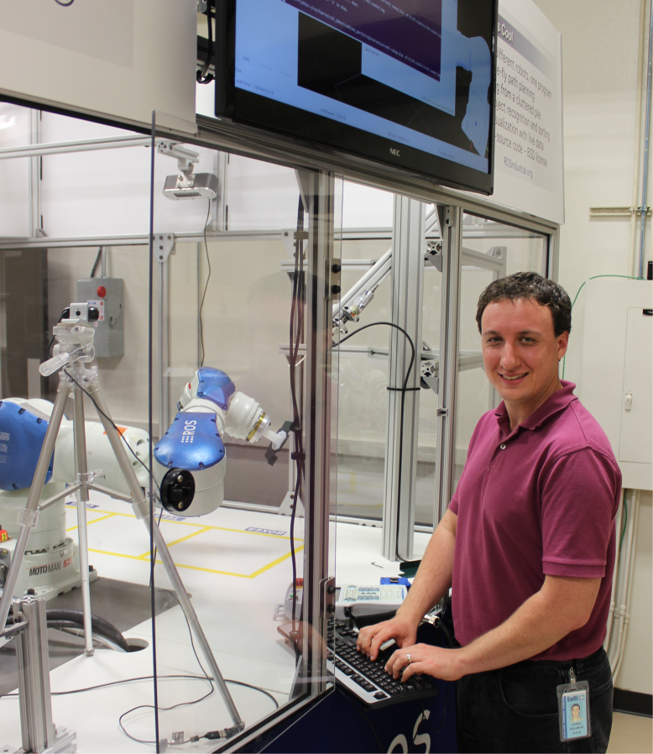
Contact Info.
Daniel Solomon
Research Engineer
Southwest Research Institute
9503 W. Commerce
San Antonio, TX 78227 USA
Phone: 210-522-3147 Email: dsolomon@swri.org
www.ROSindustrial.org

